Slide 1
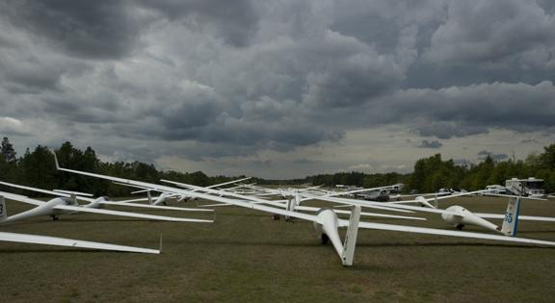
Glider Competition 101 Seminar
Chris Ruf & Wally Berry Feb 11, 2017 Much of the Content is based on the SSA Guide to Competition
Notes:
From SSA Guide to Competition: The purpose of this Guide to Soaring Competition is to promote contest safety and to make it easier for new pilots to get started in competition soaring. It is primarily directed toward the pilot who has not yet flown in a contest, but should be of some use to those with contest experience. This document will be most useful when read in conjunction with the current SSA Contest Rules and the Guide to the Rules. All contest-related documents and forms are available on the SSA website (www.ssa.org).

Slide 2
SES Glider Competition 101 Seminar
Beginners learn how to comfortably fly their first race day & have fun too!
What: Seminar to prepare pilots to fly their first contest. Not focused on how to win, but on how to avoid a lot of common beginner mistakes.
Who: Any glider pilots interested in learning how take the leap into racing - now or in the future.
Why: Pilots who learn to fly XC & Racing tend to get more out of soaring , stay in the sport longer, and enjoy years of camaraderie with fellow racers. Racing hones your cross country soaring skills and will take your flying to the next level. Beginning racers are often impressed by how much their flying improves and by how far they can fly on days they once considered marginal.
Use advice and content at your own risk! Read and talk to your instructors.

Slide 3
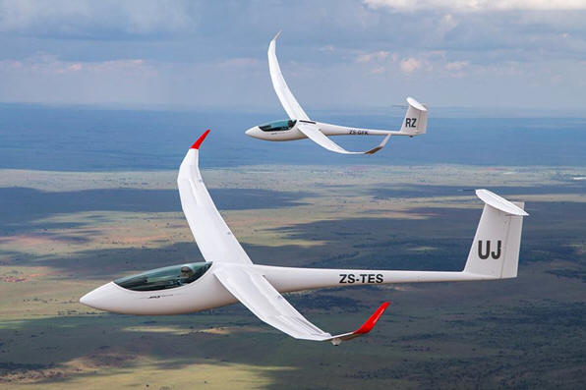
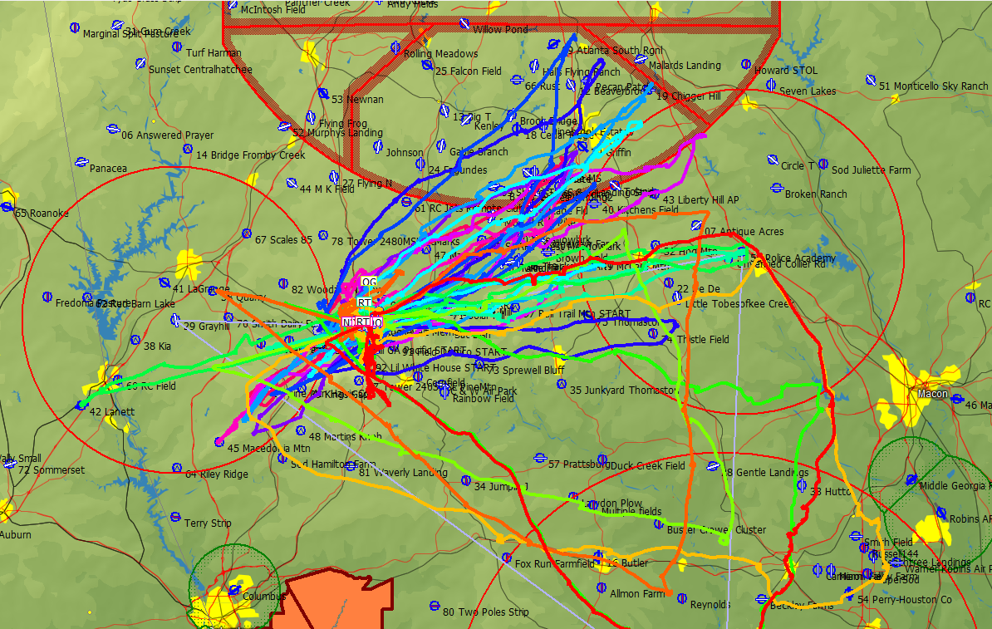
Introductions of
presenters & attendees
Name:
Where you fly:
What you fly:
Goals this year:

Slide 4
What do I need for my first contest?
What is glider racing?
Where and when are races held?
How to formally enter a race
Paperwork
Skills and Experience
Glider and Tow Vehicle
Glider prep
Trailer
Required equipment
Instrumentation
Equipment
Tie downs
Rigging aids
Ground handling equipment
Crew?
Rules
Written
Unwritten
Etiquette

Slide 5
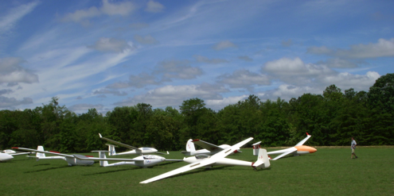
Contest Organization and Daily Routine?
Contest personnel
Manager
Director
Operations
Weather guesser
Scorer
Daily Schedule
Glider Assembly
Pilots meeting
Gridding
Launch
Start
Finish
Scoring

Slide 6
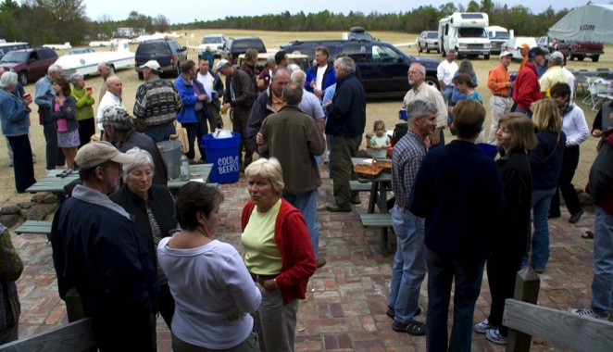
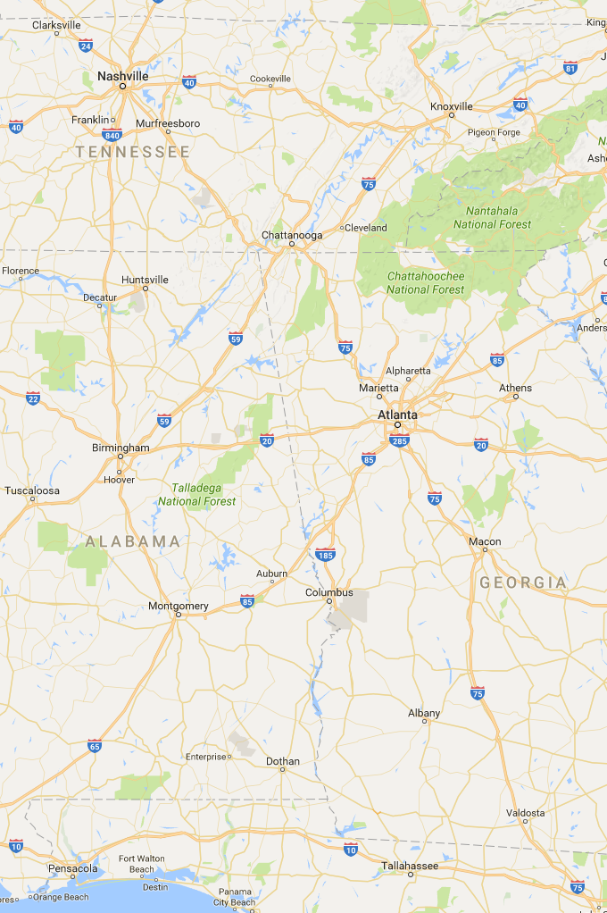
Why racing?
GTA locations
Racers & XC record and badge pilots stay in soaring longer and enjoy it more.
Explore different soaring sites = many learning opportunities.
You will learn more, faster, flying with other pilots.
Amazing to see what other pilots can do.
Camaraderie with fellow racers.
Great memories & Stories
Notes:
For many pilots, competition soaring represents the pinnacle of the sport. Concentrating solely on soaring for a week (or more) at a time tends to bring out the best in your flying. Having other dedicated pilots nearby who are doing the same certainly helps. And the chance to renew acquaintances with a circle of friends means there is much more to a contest's appeal than merely the time spent in the air.

Slide 7
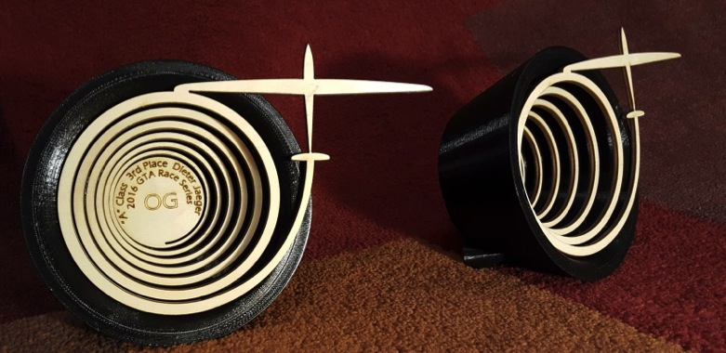
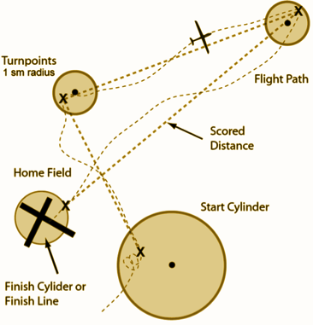
What is a glider contest?
Closed course
Conventional race: Uses a rally start where pilots choose start time as part of strategy
Grand Prix: Uses a Regatta start. Not common (yet)
Contest classes based on wingspan and presence or absence of flaps, number of seats. Also handicapped classes to allow gliders of widely varying performance to compete.

Slide 8
Competition Classes
Sports: Anything, Handicapped, MAT & TAT: Cirrus, Ka-8, SF-34, Duo Discus, ASW-20, PW-5, Ventus, Quintus, L-33, 1-26
Club: 15m max, Narrow handicap range .890-1.020, includes Assigned Tasks: Ventus .890 to 201 Libelle 1.020, Cirrus 1.000, ASW-20, 304CZ, Mosquito
15 Meter: ASW-20, ASW-27, JS-3, Ventus 2ax
Standard: 15m no flaps. Cirrus, LS-4, LS-8, Discus 2, ASW-28
“Combined FAI” 15M&Std: any of the above 2, handicapped
18 Meter: ASG-29, Ventus 3, DG-808, JS-1
Open: <850Kg: Concordia, ASH-30, Nimbus 4, JS-1, Quintus, 1-26 ;-)
20 Meter 2 seater soon: Duo Discus, Twin Shark, DG-1000, ASG-32
126 Class: Only true “1-design” class.
World Class RIP 2012, PW-5. Replaced with the 13.5 meter class.

Slide 9
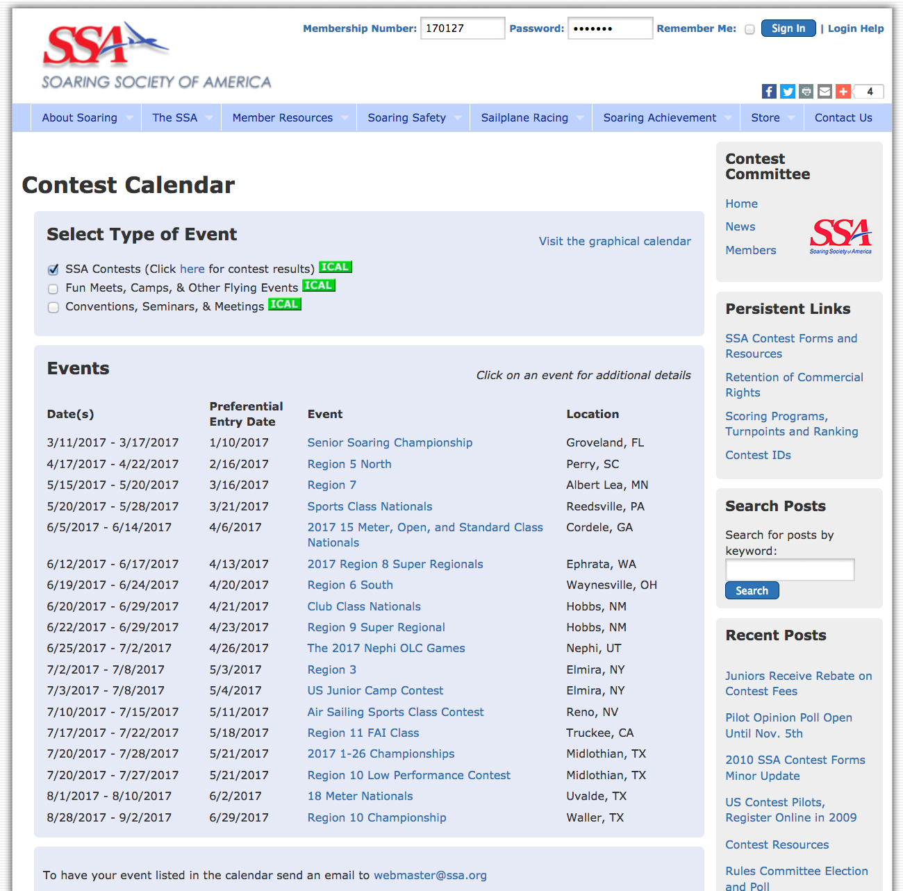
When & Where are the contests?
The SSA website has a schedule for nearly every race in North America
Check these 2 boxes for more events!

Slide 10
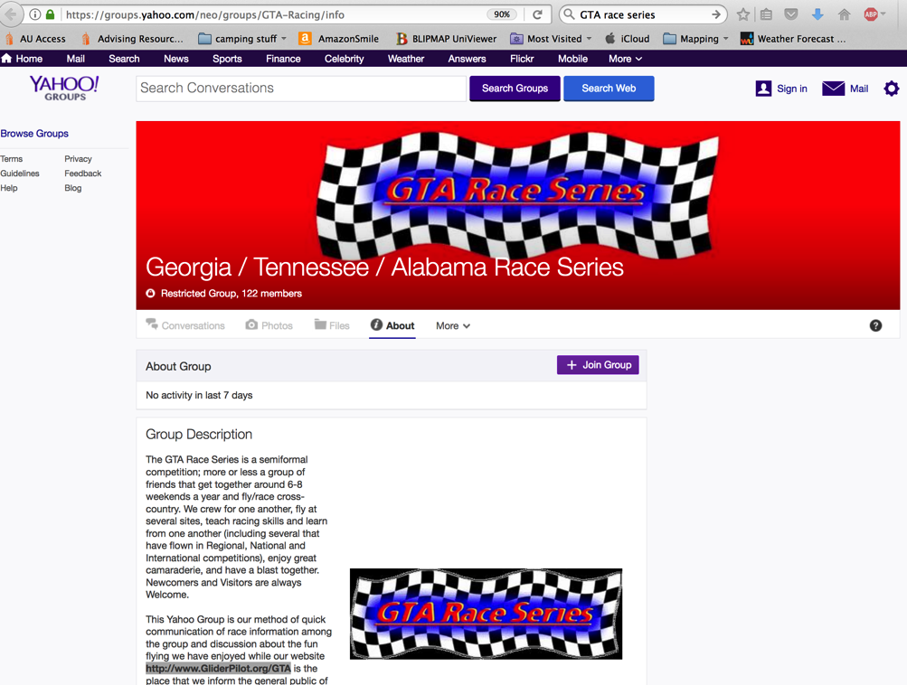
When and Where to Race?
GTA is a local race series that provides a perfect way to begin racing.
http://gta-racing.org/
http://groups.yahoo.com/group/GTA-Racing/
GTA-Racing@yahoogroups.com

Slide 11
Your First Contest
Smaller regional - not a “Super Regional” contest or National. (NOT Perry with 65 gliders!)
GTA is ideal. Usually only 4-8 gliders
Regional with 6-12 in sports class.

Slide 12
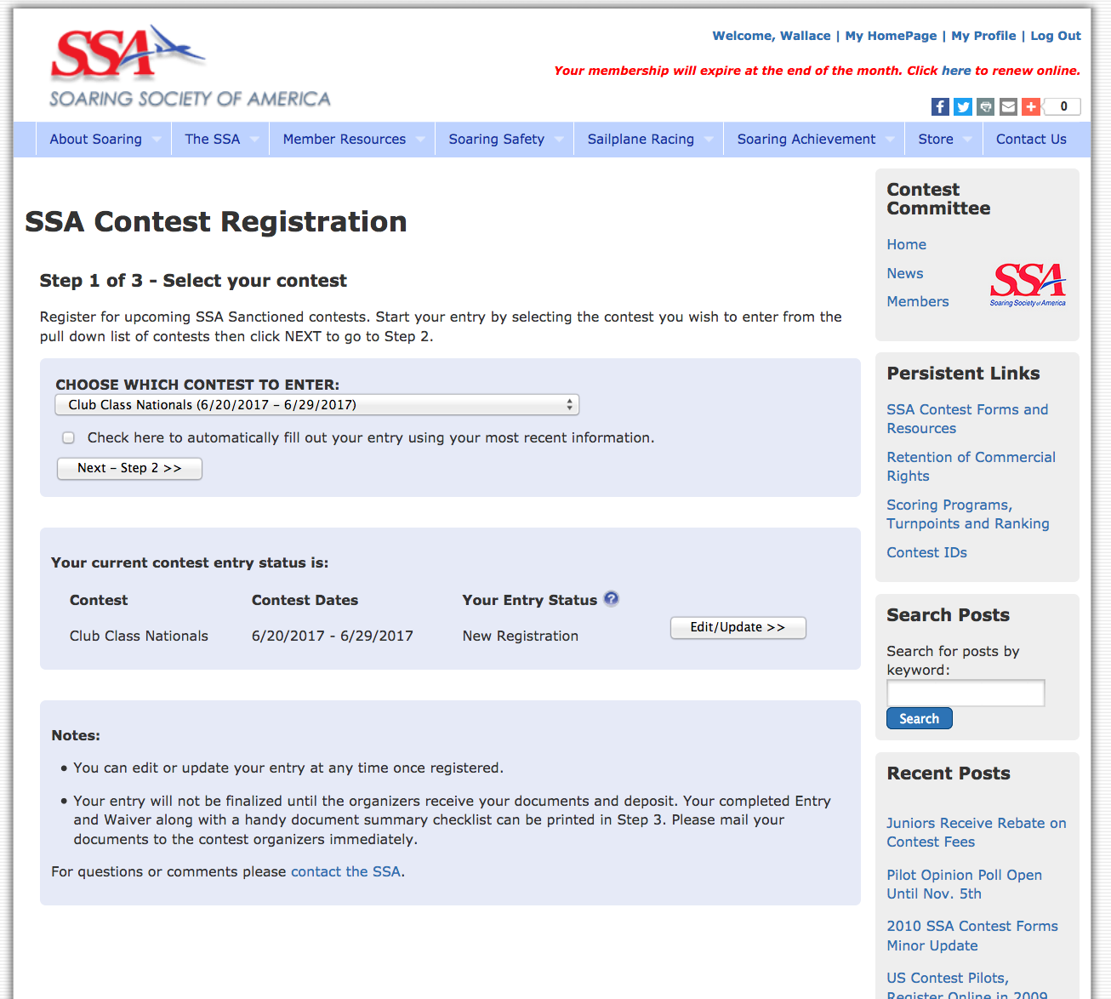
How do I formally enter a contest?
SSA Website has a contest registration webpage…

Slide 13
Paperwork Required for SSA Regional, National, or GTA
You should ensure that all paperwork is available and in order:
Airworthiness certificate
Aircraft registration
Pilot license
Insurance policy front page (as proof of coverage)
SSA Membership card (valid through the last day of the contest)
Pilot logbook (showing current BFR)
Aircraft logbook
A really good plan is to collect the first five of these items and make an electronic image of them (by scanning or taking a photo of them). This makes it easy to email copies, which is often more convenient that hard copy. For a comprehensive list of the items (paperwork, etc.) that the rules require you to bring to a contest, check out the document on Pilot Requirements under Contest Forms on the SSA website
Notes:
Contest Paperwork
When you register and pay your entry fee, you'll receive a package of paperwork. This may include tourist guides and other items of only mild interest, but certain vital items will also be there. One is the list of turnpoints and closed airspace. You'll need to get these on your chart and into your GPS navigation receiver. To do this, you'll need the current electronic version in a format compatible with your navigation system, loaded and verified to be working properly. Other pilots will be doing the same, so you should be able to get help with this. Beware of the trap of using a version of the control points that isn't quite up to date. The rules require that contest organizers include a date or version number with each control point list; you should check each time to ensure that the set you're using has this, and it's the latest one. Also among the paperwork will be some outlanding cards, at least one of which must always be in your cockpit – should you land away from the contest site, you must fill out one of these before calling the Retrieve Office. It‟s a good idea to copy the phone number(s) of the Retrieve Office onto the landing cards (or at least onto a scrap of paper for your wallet) – even during the practice period, you might need this. Another important item is a diagram of the airport, which usually includes a list of local operating procedures. You must study this and become familiar with the start and finish procedures, landing patterns, ground procedures, relight procedures, etc. It can be a good idea to review all this with a contest official or experienced local pilot, to be sure you understand everything. Don't make a launch before you understand all procedures; don‟t assume that every flight will work out just as you hope.

Slide 14
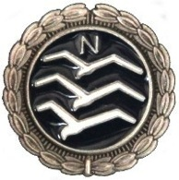
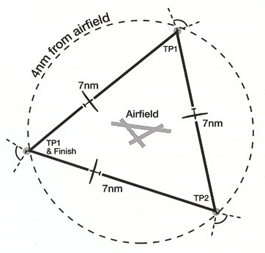
Flying Skills needed for Competition flight
A Silver badge is a good prerequisite or guideline for when you are ready to start contest flying.
FAI Silver Badge
3 required elements.
Silver Altitude is a 1,000-meter (3,281-foot) altitude gain above an in-flight low point.
Silver Duration is a 5-hour flight time after tow release.
Silver Distance is a 50-km (31.07-mile) cross country flight.
New habit: log your miles & speeds not just hours.
Prior to a Silver pilots should work on their readiness for cross country, work on skills as outlined in the Bronze Badge. Practice cross country courses even while staying close to home as shown here:

Slide 15
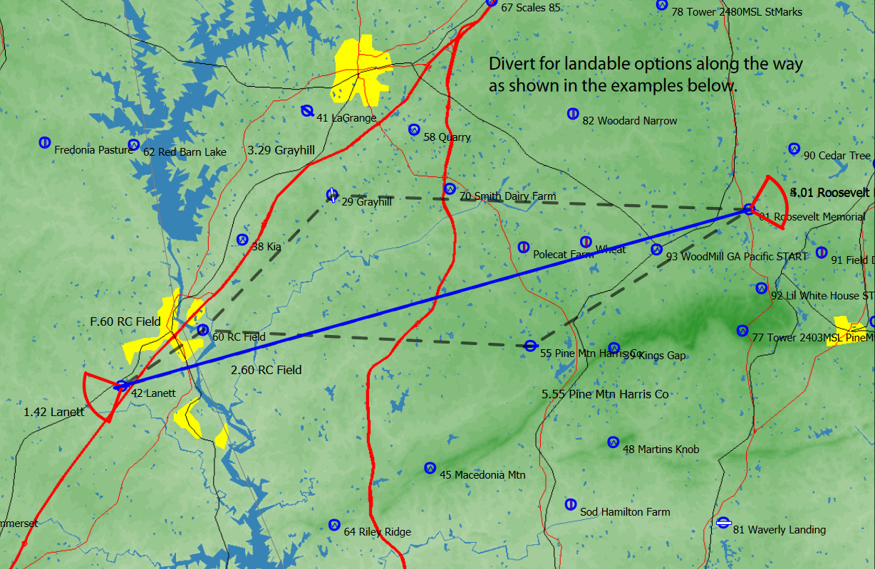
FAI Silver Badge Course Example
Warm Springs Roosevelt to Lanett = 51.9km (32.2miles) one way
Exact course line has few landing options
LaGrange Airport
Roosevelt Airport
RC Field often landable
Pine Mtn Airport
Lanett Airport

Slide 16
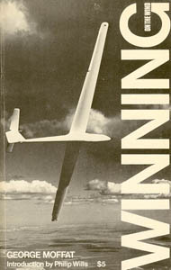
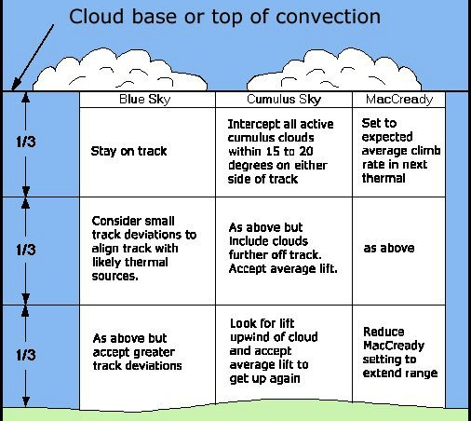
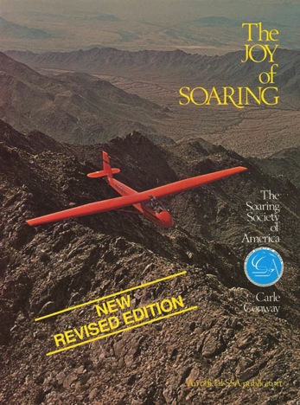
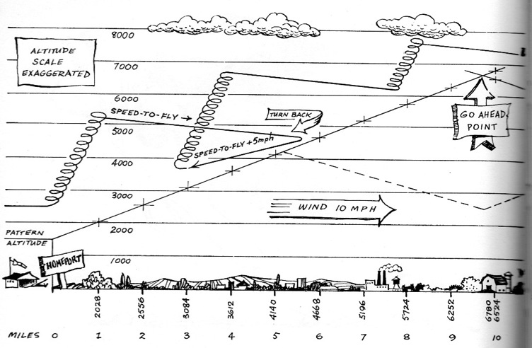
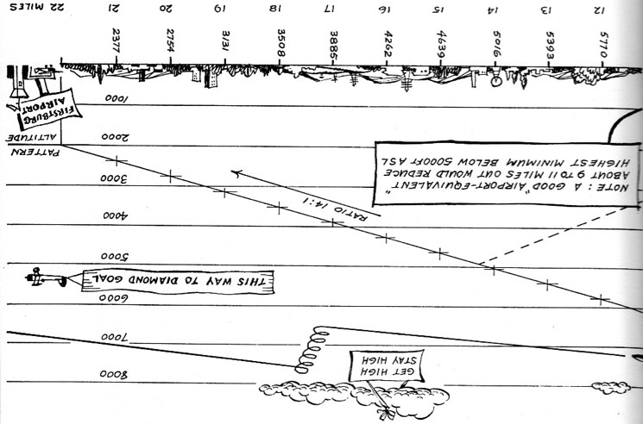
Read…

Slide 17
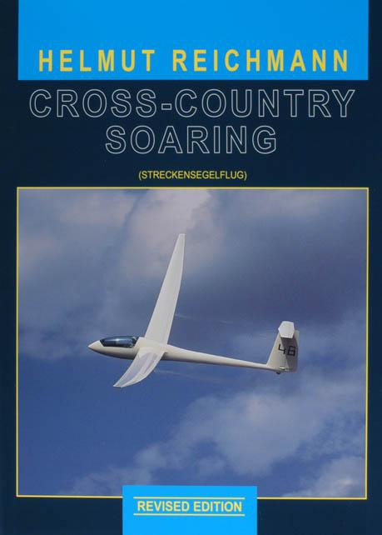
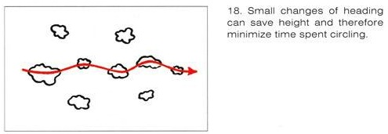
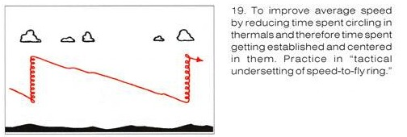
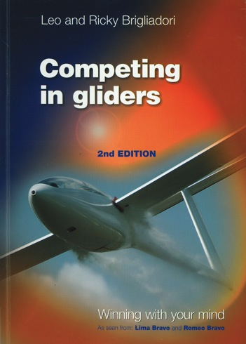
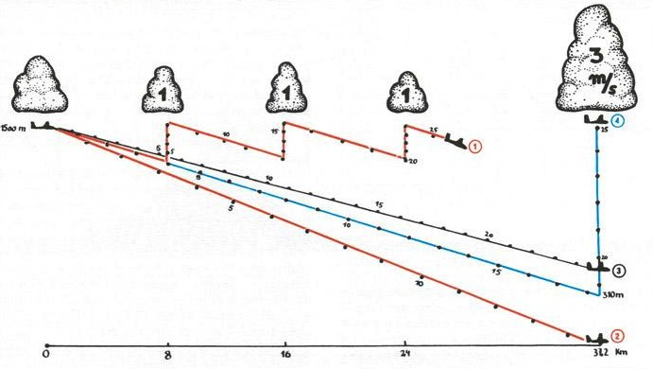
Read more…

Slide 18
Preparing Your Glider
Performance tuning hardly matters for your first few contests. It's more important that the ship trim & fly well with no annoying distractions to divert your attention.
A good audio vario is essential for contest flying.
Your trailer & tow vehicle should function well - with gas & keys.
Wing stands, tie down ropes and spikes.
Ground handling equipment: tail dolly, wing wheel, towbar, or at least a rope!
Notes:
It's tempting to think that in the time leading up to a contest a great deal of effort should be spent tuning your glider for optimum performance. In reality, the last increment of performance hardly matters for your first few contests. It's more important that the ship trim and fly well with no annoying distractions to divert your attention. Thus, unsealed aileron gaps mean little, but an air vent that howls is a real problem. You should be current and comfortable in your ship, able to stay relaxed during long flights. A few details should receive attention: It should hardly be necessary to note that a good audio vario is essential for contest flying – you'll be part of many gaggles during the course of a typical contest, and you absolutely cannot afford to fly with your head in the cockpit. Good total-energy compensation, though not critical to safety, should also be considered mandatory. Your trailer and tow vehicle should function well, since they are likely to get a workout at your first contests. Deficiencies that make your ship tough to rig or de-rig, or that leave you stranded in some distant field, are demoralizing. It's a good idea to check your batteries (a spare could come in handy) and their chargers – a dead radio or vario would be most unwelcome. If the upcoming contest will involve high-altitude flying, make sure your oxygen system is tested and thoroughly dependable (remember, this is life support equipment).

Slide 19
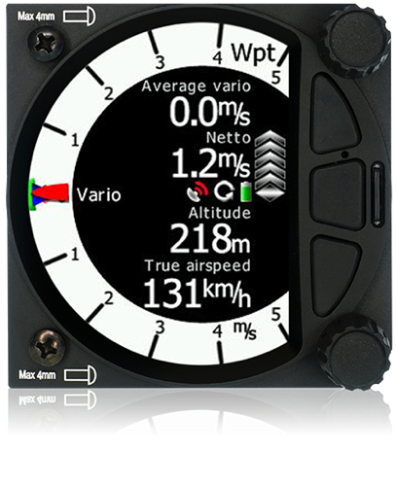
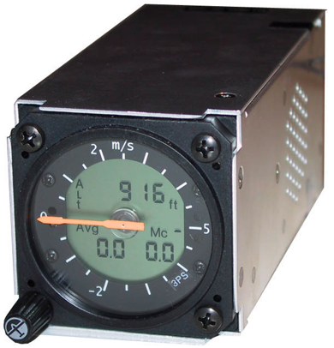
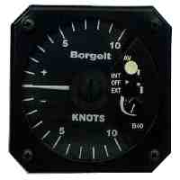
Equipment
A good audio vario and a moving map navigation system are essential for contest flying.
Need not be state of the art or expensive!

Slide 20
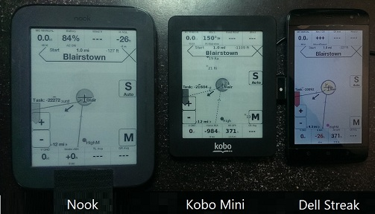
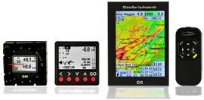
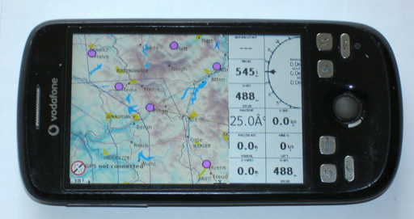
Equipment
Nav systems

Slide 21
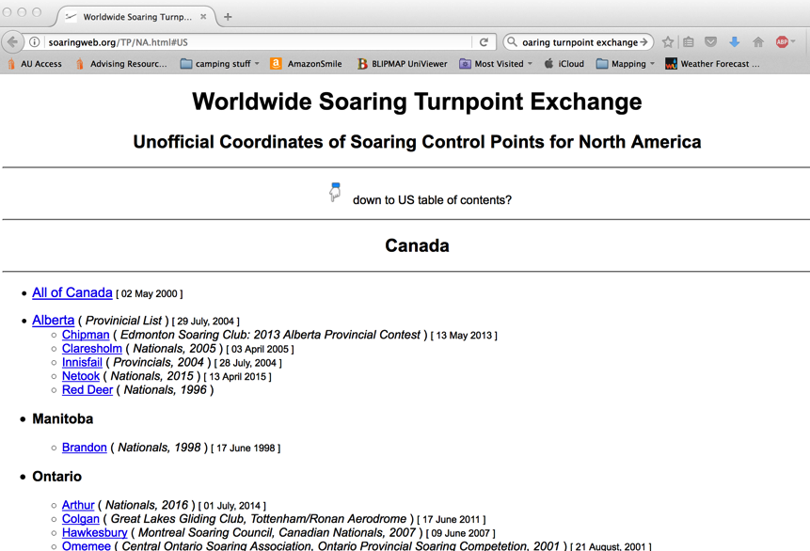
Preparing Your Glider
Don’t forget to download the updated contest site files to your nav system!
Free at soaringweb.org/TP/NA.html#US

Slide 22
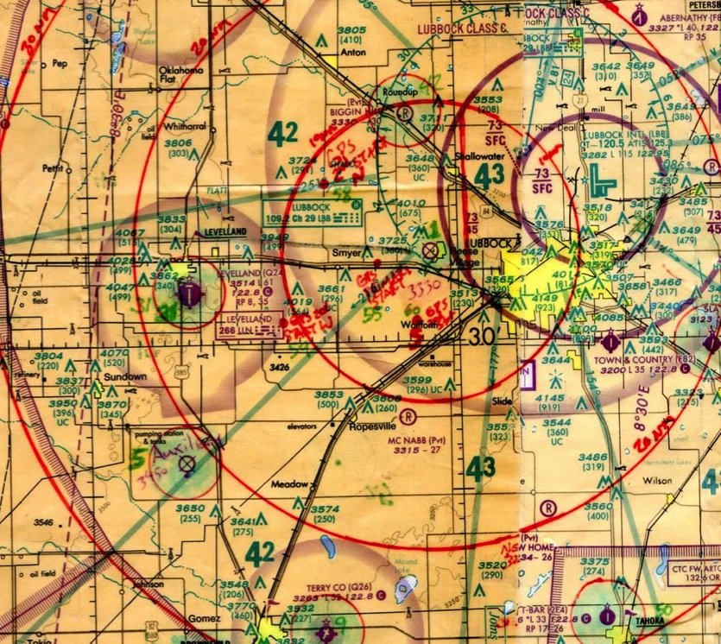
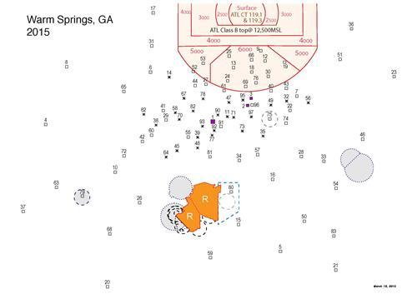
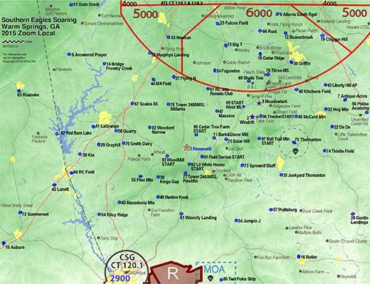
Charts/Maps/Turnpoint maps
Marked up Sectionals & printed maps are still helpful (sectionals are still required equipment)
Situational Awareness & frequencies.
Chart prep = learn contest area.
x
Notes:
You’ll want a good chart of the contest area. Most pilots make such a chart by pasting together the appropriate pieces of FAA Sectional Charts, then covering them with clear plastic film. Before covering, each turnpoint should be clearly marked. You'll be able to get some good ideas on chart preparation by looking over the shoulders of experienced pilots, or asking for their help. In the GPS age, less emphasis is placed on printed charts than previously. But it's a mistake for anyone unfamiliar with a task area to be without a good one.

Slide 23
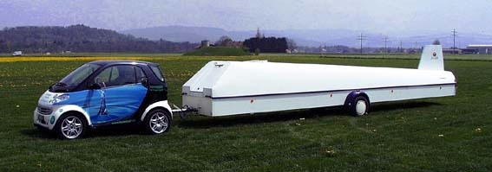
Equipment
Your trailer & tow vehicle should function well
Adequate tow vehicle!
WITH gas & keys!!!!
Lights working
Proper hitch and ball
Spares and tools

Slide 24
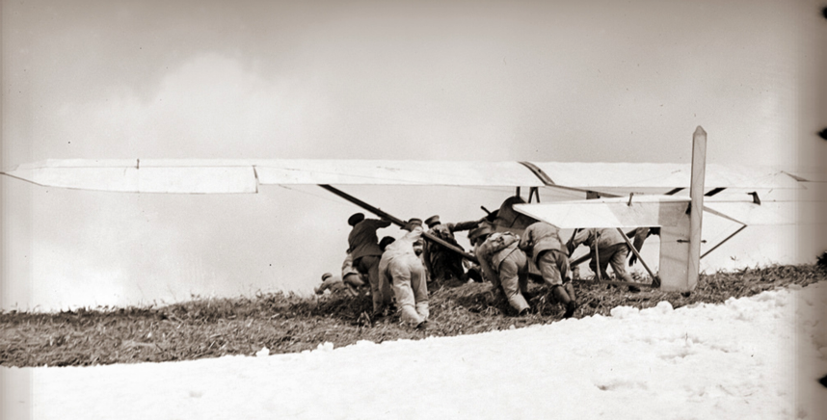
Equipment
Wing stands, tie down ropes and spikes.
Ground handling equipment: tail dolly, wing wheel, towbar, or at least a rope!
Ground handling equipment becomes absolutely critical if you are without a crew!
Notes:
Be prepared to be self sufficient

Slide 25
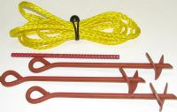
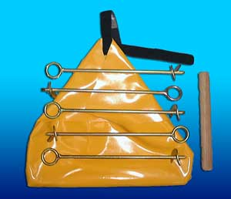
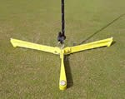
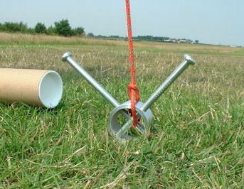
Equipment
Tie Downs: For glider and trailer
Notes:
Required by the rules to tied down your trailer and glider to protect other people and their gliders.

Slide 26
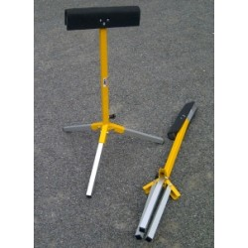
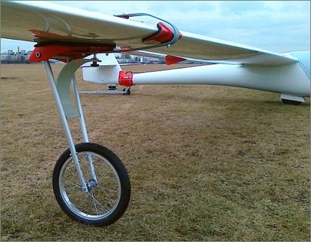
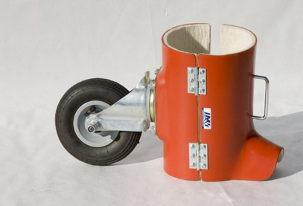
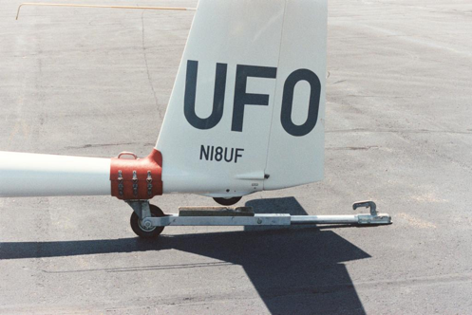
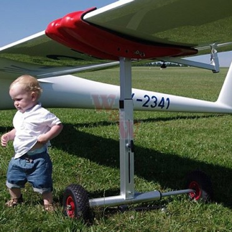
Equipment
Rigging & Ground Handling (Don’t leave home without it!)
Label with your contest #
Self Rigger is optional
- plenty of help around
Tow bar and wing wheel allow you to grid yourself.
Using just a rope requires 2+ people.
Notes:
Good checklists can be vital, particularly at a contest. Pressure and distractions make it easy to overlook important items; checklists help combat this tendency.

Slide 27
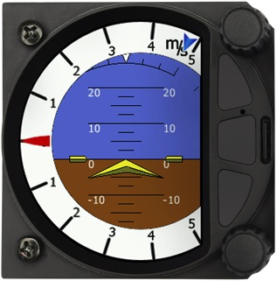
Required Equipment, Restricted Equipment
Required:
Glider - club glider, partnership, borrow, or your own.
Parachute
Emergency Location Devices: Emergency Locator Transmitter (ELT) or Position tracker like Spot
Aircraft-band VHF radio.
Prohibited from carrying:
Any instrument which: Permits flight without reference to the ground = Artificial Horizon.

Slide 28
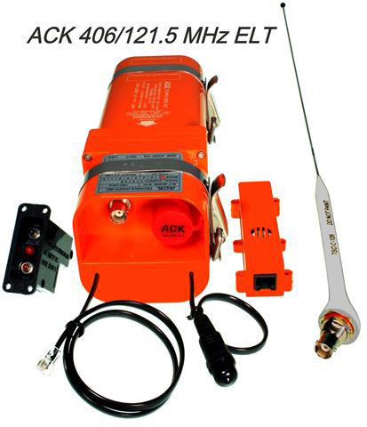
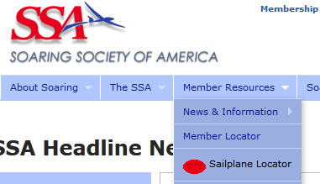
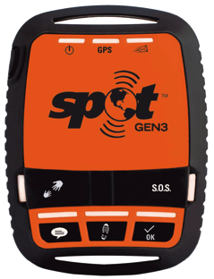
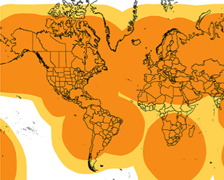
Outlanding Preparations, Landing Out, reporting in, tracking systems & ELTs
Get a tracking system & register it on SSA’s “Sailplane locator”. FYI there are 2 tracking systems on SSA, the “locater” is better for friends & family to find you.
SPOT Gen3 Satellite Messenger
DeLorme inReach Explorer 2-way Satellite Communicator with GPS & Navigation
Notes:
Emergency Equipment: As a responsible competitor, you'll place great emphasis on flying safely. You should also allow for the possibility that a problem might occur. This means that an adequate first aid and survival kit should be on board. It also means that you should give careful consideration to installing an ELT (Emergency Locator Transmitter). An ELT has proven value in case of a crash; some contests require them. Also useful is a satellite-based tracking device such as the SPOT. This allows your progress to be tracked in “near real time” – a position appears about every 2-10 minutes. Should you not arrive when expected, your last reported position would be easy to determine. It's an excellent idea to carry a mobile phone, a spare battery, and possibly a means of powering it from your glider‟s battery. You shouldn't assume that coverage will always be available, but this will be useful after most outlandings, and occasionally in case of an emergency.

Slide 29
Checklists
Suggested checklists:
Equipment to take to the contest (it's discouraging to find that you left your battery charger at home)
A thorough assembly checklist
A pre-flight checklist
A pre-landing checklist
A trailering checklist (showing how to hook up your trailer and start your tow vehicle)
Cell phone belongs on checklist.
Your pre-flight checklist should include several contest-specific items, such as the need to ensure that a task sheet and outlanding card are in your cockpit, and that the keys to your tow vehicle are not in your pocket. Your landing checklist is one you may wish to commit to memory, since contest landings can get busy
Notes:
Good checklists can be vital, particularly at a contest. Pressure and distractions make it easy to overlook important items; checklists help combat this tendency.

Slide 30
Checklists
www.skysoaring.com/members/TR_Pilot_Crew_Checklist.pdf
Notes:
Good checklists can be vital, particularly at a contest. Pressure and distractions make it easy to overlook important items; checklists help combat this tendency.

Slide 31
Flight Documentation
Flight Documentation = fancy way of saying .igc flight recording.
Many software & hardware options.
iPhone and Android apps for GTA & regionals (XCSoar, iGlide, SeeYou Mobile)
Input your Name, Contest Number & Glider type to make a scorable .igc file.
Notes:
Your contest flights are documented with a GPS Flight Recorder (FR). You need to be sure that it is properly mounted and if it has a navigation display this can be clearly seen during flight. Obviously, reliability is important. By far the most common cause of failures is loss of power (batteries go dead, cable becomes disconnected, etc.) so make sure your installation is reliable. The FR should be easy to remove from the glider so it can be submitted to the Scorer after a contest flight – or you should know how to get the flight log file onto portable storage, such as a memory card or thumb drive). Turnpoint control with a Flight Recorder is reasonably simple. The FR keeps a continuous record of your position, so you simply fly to the turnpoint, then press on toward the next one. The Rules require at least one fix within the specified radius of the turnpoint (1 mile for all tasks except the Turn Area Task, described below). Many pilots have taken this to mean that they could turn at the defined radius. But few have persisted with this technique – they've found it's far too easy to wind up with a flight log that shows they never got quite close enough. If you want to avoid occasional penalties, plan to get well inside the cylinder – by at least 0.1 mile. And while you do so, don't forget the importance of keeping your eyes outside the cockpit: turnpoints attract gliders. Here's a small point worth attention: Pilots have various notions of how to set up their instrumentation. You may be among those who prefer to use nautical miles or kilometers for distance. If so, be aware that contest distances are always expressed in statute miles. Unless you are really careful, it will be easy to make a distance mistake at some turnpoint. For contest flying, either use statute miles or remind yourself to take great care with the distance conversion at every control point.

Slide 32
Staying comfortable, and Safe:
Drinking Water
Snacks keep your blood sugar in the right range, and backup food for a landout.
Pilot Relief
Oxygen in Western US
Notes:
On any contest task proper provision for “pilot relief” (urination) can be important. A pilot who comes to a competition without having planned (and practiced) for this is truly unprepared and has created a huge obstacle to success. (Ask yourself if it makes sense for a beginner to try to compete with a handicap that no experienced pilot would for one moment consider.) Many beginners feel that this is an inconvenient subject and that they can probably get by "on one tank". What they don't realize is that the pilot's situation (semi-reclined, moderate vibration, moderate level of stress, changes in altitude accompanied by changes in temperature) is highly conducive to frequent urination. Many experienced pilots use gallon-size ziplock baggies, though other arrangements can work well (a recent trend is toward the use of an overboard relief tube and a „male external catheter‟). You may wish to check out the various systems used by experienced contest pilots. Without question, this must be a part of your pre-contest practice – neglect this subject at your peril!
A related subject is the need for drinking water. Physiological studies have shown that a glider pilot who fails to drink will soon become dehydrated, and that this dehydration will impair performance, perhaps dangerously. Obviously, dehydration is aggravated if the pilot avoids drinking to reduce the need for “pilot relief”. An ample supply of drinking water must be carried (and consumed) on every flight. A quart is minimal – a half-gallon is far better (in really hot weather, you'll need as much as a full gallon). A popular arrangement is a bag or a plastic bottle and a hose through which water can be sipped. You should keep the hose handy at all times, and get in the habit of drinking small amounts frequently. (If you wait until you're thirsty, you're already a quart low.) In any hot climate, make a point of drinking a really large quantity of water in the hour before takeoff. This will ensure that you don't start out partially dehydrated.

Slide 33
Crew
Crews help a lot, and crewing is a good way to learn - try it.
Now common to create a Crew-for-Each-Other-Group as secondary plan.
Nobody has been left in a field forever as far as we know.
Notes:
Though some pilots fly "crewless," you should try to arrange for a reliable crewperson. The crew's basic duty is to reduce the strain on you, the pilot. Specific duties include helping you to prepare and grid the glider every day, running your wing on takeoff, greeting you with tail dolly (and a cold drink) on landing, and, of course, retrieving you when you land out. A good crew approaches all these tasks eagerly, and takes special pride in cleaning the glider every day. A good crew should be able to listen at great length to your stories of how the day's flight went, offering praise, sympathy, encouragement, and no criticism. Both you and your crew must be realistic about the large effort that a contest can involve, and how easily strain can creep in unless both work to avoid it. Contest flying tests your character in many ways. You must be careful not to blame your crew for shortcomings that are really your responsibility. You may have asked your crew to find your chart and put it in the cockpit, but if you fail to check and take off without it, the fault is still yours. And items critical to flight safety (such as checking control hookups) must not be delegated. One final point: In getting ready for competition, no form of practice or preparation is half as valuable as the chance to act as crew for an experienced pilot. This is so useful that it should almost be considered mandatory for anyone who is contemplating competition flying.

Slide 34
The Rules
Good Idea to read them at least once - might save you from losing all the points for a day.
Guide to the Rules at the end are really helpful.
Pay particular attention to the rules concerning turnpoint control, starting, finishing, & penalties.
Left Circling within 5 miles of the contest site or within an active start cylinder.
Regionals & Nationals
ssa.org/ContestRules
Notes:
Considering the time, money, and effort that pilots expend on a soaring contest, you'd think they would make a point of knowing the rules. Alas, it is not so. Even pilots with considerable contest experience sometimes have a hazy understanding of the rules by which they fly. Avoid this trap – get a copy of the current rules (available on the SSA website) and study them carefully. Pay particular attention to the rules concerning turnpoint control, starting, finishing, and penalties. Understand the types of tasks you might be flying and at least the basics of the way in which scores are calculated. Be a trifle skeptical of what other pilots tell you about the rules – their understanding may be good or hazy, and they may or may not have kept up with recent changes.

Slide 35
Rules: Site Specific
Every race site has their own unique operating procedures and rules.
Provided on the contest website and in printed documents made available before or at the contest.
READ THEM!
Notes:
Considering the time, money, and effort that pilots expend on a soaring contest, you'd think they would make a point of knowing the rules. Alas, it is not so. Even pilots with considerable contest experience sometimes have a hazy understanding of the rules by which they fly. Avoid this trap – get a copy of the current rules (available on the SSA website) and study them carefully. Pay particular attention to the rules concerning turnpoint control, starting, finishing, and penalties. Understand the types of tasks you might be flying and at least the basics of the way in which scores are calculated. Be a trifle skeptical of what other pilots tell you about the rules – their understanding may be good or hazy, and they may or may not have kept up with recent changes.

Slide 36
The Unwritten Rules
For any sport, the rules that aren't written can be as important as those that are. A brief list of the things you should be trying to achieve in soaring competition, in decreasing order of importance. The first four should be considered mandatory on every flight.
Don't endanger people on the ground
Don't endanger other pilots
Don't endanger yourself
Don't endanger your glider
Learn from the flight
Enjoy the flight
Score well

Slide 37
Airport Etiquette
Beyond the published airport rules, there is contest etiquette that all pilots (and crews) should observe:
Around the airport, drive at moderate speed (don't terrify pedestrians or stir up dust)
Don't leave cars or gliders where they block others
If your car might block anything, leave the keys in it.
Drive around, not across, runways, unless you are certain it is allowed and safe
Display your contest ID on your car & trailer (makes them easier to find)
Whether on foot or in a car, always defer to aircraft
Treat contest workers politely (remember, they are volunteers)
Be considerate of non-contest airport traffic (so the contest gets invited back next year)

Slide 38
Contest Personnel roles
Competition Director, the head honcho – the one who calls tasks, and is responsible for ensuring that the contest is a safe, fair soaring competition.
Contest Manager, responsible for administration of the contest. The CM organizes all the volunteers, ensures that there are enough towpilots, towplanes, towropes, water faucets, porta-potties, etc.
Weatherman, responsible for monitoring weather observations & forecasts, and presenting this information to pilots each day. As we all know, meteorology is an inexact science, and it often pays to be a bit skeptical of the day's forecast.
Scorer, keeps track of the results achieved by all pilots every day, entering these into a computer, and producing scoresheets.
Retrieve Office, group of volunteers who take phone calls from pilots that have outlanded.

Slide 39
Preparation for the day
Prepare early; then relax before the flight.
Work your checklists.
Typical:
8:00 show at glider 9:30 Pilot meeting 11:30 glider near/next to grid 12:00 on grid spot
12:10 grid meeting
12:25 first launch
Notes:
Your first duty on any contest day is to get your ship assembled and ready to fly. You should expect this to take longer than normal, because of the special needs of contest flights (contest paperwork, ballast, etc.). Pay particular attention to having all necessary items (task sheet, outlanding cards, chart, etc.) in the cockpit, and all unnecessary items (e.g. yesterday's task sheet) out.
You'll want to have a good Critical Assembly Checklist, and to do it properly each day. As you know, this is an independent check of the items on a particular glider that the manufacturer, common sense, and the service history say are critical to safe flight. The list should be kept short – this is not a substitute for your comprehensive assembly checklist, but a separate check of the truly vital items. You crew can help you do this. Each day, make a mark on the left wing-root tape signifying that it is complete.
With luck, you and your crew will "hit your stride" during the contest, with assembly and preparation becoming a smooth operation. A good goal (not always achieved) is to have the plane entirely ready to go before the morning pilots' meeting. No matter what it takes, you must make a point of being fully ready to fly by grid time (the time when gliders are pushed out on the runway in preparation for launch). You should take this seriously (it tends to be a weak area for novices) because many problems can develop when you are almost but not quite ready to launch on time.

Slide 40
Pilot’s Meeting
x
x
Notes:
The first "event" of the contest day is the pilots' meeting (typically held in a hangar or meeting room at around 9:30). Here, the previous day's winners get a chance to describe their flights, and perhaps receive a small prize. The weatherman explains why the forecast for the previous day was less than perfect, and offers a guess about today's conditions. Various administrative notes and comments are presented. Each pilot receives a bunch of paperwork, typically consisting of a scoresheet, a weather summary sheet, and a task sheet. This last item is the most important. Typically, it lists two or three tasks that might be used, depending on how the weather actually develops; it should be placed in your cockpit.

Slide 41
Gridding, Launching & Relighting
x
x
Notes:
This is the busy crowded grid at a 65 glider contest at Perry

Slide 42
Gridding, Launching & Relighting
x
x
You’re doing it wrong!
Notes:
This is the busy crowded grid at a 65 glider contest at Perry

Slide 43
Gridding, Launching & Relighting
x
x
Typical Contest Launch
Notes:
Typical Contest Launch ;-)

Slide 44
Water Ballast
Water Ballast - not needed for sports or club class
Notes:
Use of waterballast is prohibited in Sport Class & World Class, but in other classes it can be important. Clearly, you should be familiar with all aspects of your ballast system well before using it in a contest flight. You'll need a reliable filling system. One simple approach uses a large (truck-size) inner tube with attached valve, hose and fittings that is placed on top of your tow vehicle, filled from a hose, then drained into the wings. Bear in mind that overpressure while filling can lead to serious wing damage; if the drop from the top of your vehicle to the wings is more than about four feet, arrange some sort of reliable pressure relief. Go through the filling process until you are confident everything works as it should. Bags and valves that have gone unused for quite a while often develop leaks – make sure yours are reliable.
With full ballast, your glider may exceed the allowable maximum weight and so you'll have to dump some water by opening the valves for a certain amount of time. To determine this time, you'll need a set of scales (one will be available at the contest for this purpose). If you ignore this important calibration you stand to lose a lot of points in penalties.
Flying with Waterballast
Though the use of water can give a boost to your speed on days with large, predictable areas of strong lift, it entails some real disadvantages. Among these are sluggish handling, decreased rates of climb (on tow and in thermals) and additional energy to dissipate on landing. When you do fly with water, watch your achieved climb rates to decide how much you really should be carrying (an old rule of thumb says that if you aren't averaging 4 knots from the bottom of a thermal to the top, you should consider dumping ballast). If you decide to dump, you must not do so in a thermal, unless you are certain you are below all other gliders: wetting down other pilots' wings is considered very bad form. Be sure you know how long it takes to dump ballast, and start to do so in plenty of time before landing. This is especially important for off-field landings: ballast puts extra strain on landing gear and brakes, and encourages groundloops.
Be aware of the hazards when empty and full gliders are using the same thermal: the empty ones may have a real advantage in rate of climb, so vertical spacing can change quickly. And be especially alert for problems in the first part of your takeoff roll – if a wing goes down and you can't raise it within one second, it‟s probably best to release and try again.

Slide 45
Radio Usage
123.3 Contest, CD, Pilot to Pilot Safety
123.5 Pilot to Crew (pilot must initiate - cannot start with crew calling pilot.)
Unicom at public airports
Notes:
Proper use of the radio is a small but important part of contest flying. Details of radio procedures used during the start and the finish are discussed below. Here, we'll take a short look at the general subject of radio usage. Today, a high-quality 720-channel radio can be found in the cockpit of nearly all competition gliders. Yet in most cases all that’s required is a radio that can receive and transmit on two frequencies: 123.3 MHz and 123.5 MHz. Clear reception and transmission are important: a radio that is hard to hear will annoy you, and one that transmits with screeches and squawks will annoy everyone else. All contest business (starts, finishes, etc.) is normally done on 123.3. You are required to be on 123.3 during the entire pre-start period and when you finish. You may be required to report your start time via radio, and certain calls are required when finishing (see below). You’re expected to monitor 123.3 during the entire flight, to allow safety-related pilot-to-pilot communication (such as "Alpha Bravo Charlie, this is Xray Yankee Zulu – I'm passing close-by on your right"). Other than for this purpose, pilot-to-pilot communication is forbidden. Pilot-crew communications are allowed on 123.5, but must be initiated by the pilot, and a crew may not give a pilot weather or tactical information. You should reach an understanding with your crew as to how often you'll call back with a status report. Some pilots do this frequently; others simply say, "See you later this afternoon". In general, the goal is to minimize radio chatter. You'll find that talking tends to distract you from your flying. One particular time to bear this in mind in when conditions are tough and you are close to an outlanding – it's nice to keep your crew informed, but it's more important to get the glider safely on the ground. Don't involve yourself in distractions when they might hurt your performance.

Slide 46
Charts/Maps/Turnpoint maps
Marked up Sectionals & printed maps are still helpful.
Situational Awareness & frequencies.
Chart prep = learn contest area.
x
Notes:
You’ll want a good chart of the contest area. Most pilots make such a chart by pasting together the appropriate pieces of FAA Sectional Charts, then covering them with clear plastic film. Before covering, each turnpoint should be clearly marked. You'll be able to get some good ideas on chart preparation by looking over the shoulders of experienced pilots, or asking for their help. In the GPS age, less emphasis is placed on printed charts than previously. But it's a mistake for anyone unfamiliar with a task area to be without a good one.

Slide 47
Navigation
GPS flight recorder is required so you’ll have GPS.
A moving map is massively helpful - to understand Start, Finish, Turn Area points, and staying out of Airspace.
What system is not as important as knowing how to use it well. Practice on the ground in Simulator mode.
Notes:
GPS navigation receivers are now almost universal in gliders used for cross-country soaring. Yet there are still some navigation details that must be attended to the old-fashioned way.
You should learn the local landmarks, and the areas of good and bad outlanding fields. During practice flights try to visit as many different turnpoints as possible – flying through a familiar area is always easier. Pay particular attention to areas that the local pilots feel are tricky. Your objective is to be able to find a turnpoint from any direction, and to form some idea of the nearby landing possibilities.
One specific navigation detail should receive careful attention during the contest practice period: you should be able to pinpoint the exact location of the home field from low altitude in any direction from which you might be doing a final glide. Often, the angle of a final glide is shallow enough that the airport itself cannot be clearly seen, and nearby features (e.g. a hill, a lake) provide the necessary clues.
You should also check the landing possibilities within 5 miles of home along the final glide routes. You have no business making a close final glide until you know what your options are if it doesn't work out. If there is any question, you‟ll do well to visit some of the nearby fields – if you have to land there because a final glide went wrong, you probably won‟t have much altitude and will be glad of having done your “homework.”

Slide 48
Airspace
How to earn Minus 100 points for the day!
(Lose all your points for the day & 100 more).
{
Notes:
Serious Airspace clearance violation (Rule 10.12.3): penalty = 100 + loss of all daily points.
10.12.3 Airspace clearance requirements
10.12.3.1 Horizontal - A serious violation occurs if any fix lies within closed airspace.
10.12.3.2 Vertical - A minor violation occurs if any fix has a vertical separation from closed airspace less than 500 ft but not less than 100 ft; a serious
violation occurs if any fix has a vertical separation from closed airspace less than 100 ft.
10.12.4 Penalty application. Multiple minor airspace violation penalties (Rule 12.1.4.10) may be applied to one flight, but not more than one per 5 minutes. No more
than one serious airspace violation penalty (Rule 12.2.5.6) shall apply to one flight. When both minor and serious violations occur, only
the serious violation shall be applied.
10.12.5 Gaps in a Flight Log longer than one minute shall be interpreted unfavorably to the pilot. During each such gap:
• the closest horizontal approach to or from the nearest closed airspace shall be calculated assuming a speed of 100 mph
• if in the judgment of the CD there was any realistic possibility of a vertical airspace violation, the closest vertical approach to the
nearest closed airspace shall be calculated based on a vertical speed of 1000 feet per minute.

Slide 49
Start Points, vs Turnpoints & Finish points.
Important to understand that waypoints have various attributes. Some have multiple attributes.
Some are Turnpoints, Start, Finish, non-turnpoint airports.
Do not use a point with only Start Point attribute for a turnpoint.
Turnpoints lists that have the Number at the beginning of the name cause the least confusion.
Remain skeptical of airport attribute.
Worldwide Soaring Turnpoint Exchange: soaringweb.org/TP

Slide 50
Landing Out
Decide early: stop soaring start landing.
Wires
Wind
Slope
Surface
You should already be comfortable with landouts. Steep approach & pattern at home like landout every time.
Notes:
Outlanding Preparations - Your pre-contest cross-country flying should have included a number of landouts – it would be a bad idea to come to a contest without a good idea of how to evaluate fields and make safe off-field landings. Because tasks are set on all flyable days – including weak ones – the chance of outlanding is good.
It is important to develop a reasonable idea of the landout possibilities in the task area, both from discussions with local pilots and from your own observations. You should learn any special tricks about judging slope and surface quality, and the nature of local land usage (What crops are high or low? Are any particularly valuable? What do they look like from the air? Are there landable pastures? What do they look like from the air?). An hour's drive to inspect typical fields may pay real dividends later.

Slide 51
Task Types & Planning AT
Assigned Task Not used in Sports Class
Notes:
Assigned Task This task has been in use for many years and is thus understood by most CDs. It is best in contests where pilot skill is reasonably uniform, and on days when the weather forecast is thought to be reliable and does not include problems such as thunderstorms. Using the help of the weatherman and the task advisors, the CD should estimate the speed that the day winner is likely to be able to achieve, and the amount of time available from task opening to the end of soarable conditions. The right task length is then the distance that a pilot who maintains 75% of the winner's speed is able to cover in the time available.
The Assigned Task is appropriate when sailplane performance, pilot skill and weather uncertainty are all within a range that the CD feels is acceptably small. As an alternative, consider a MAT with a sufficient number of designated turnpoints that the assigned part of the task will consume most or all of the minimum time as this choice allows pilots who do not achieve projected speeds to return home after any turnpoint.

Slide 52
Task Types & Planning MAT
Notes:
Modified Assigned Task The MAT is especially well suited to contests in which pilot ability varies considerably, and to days where the weather may be significantly better or worse than the forecast. Because it is time-limited, it "scales itself" to the actual conditions of the day, and to the abilities of individual pilots. The CD has many options here: He can assign a large number of turnpoints - so many, in fact, that it is impossible for any pilot to complete them
all, in which case the task becomes like an Assigned Task but with the option for those who are slow to return after any turnpoint. He can assign few or no turnpoints, which makes the task like the old Pilot-Selected task. (Note that when no points are assigned, the CD can restrict the choice of the first turnpoint, for example to send the pilots into the same general area without specifying just one point.) Some care is needed when assigning turnpoints. It is best for the increment in distance for completing assigned turnpoints decrease for successive assigned points. If this is not the case, then late in a flight a pilot can be faced with the choice of coming home early or having to fly a large extra distance, which can be luck-prone.
Strategic considerations for pilots flying modified assigned and turn area tasks
With a Pilot-Selected task there are more choices. The most important is where in the task area the best soaring conditions will be found. The clues for this decision are the terrain, the weather forecast and especially the actual view of clouds and weather you get from the cockpit. If there is evidence that lift is "streeting", you should look for a course in which turnpoints line up with lift streets. It is important to keep all turnpoint restrictions in mind (especially prohibited task legs). Other things being equal, a course with fewer turnpoints is preferable, since every turnpoint tends to involve at least some delay.
Here are the turnpoint restrictions you must keep in mind (see Rule 10.3.2.2):
- A maximum of 11 turnpoints (or a smaller number as set by the CD) may be claimed.
- Certain turnpoints may be prohibited.
- Certain task legs may be prohibited.
- You must have at least 2 intervening turnpoints before repeating a turnpoint (but note that the start and the finish are not turnpoints).
- The CD may impose extra restrictions on the selection of the first and last turnpoints.
- The CD may restrict the total number of times that certain turnpoints may be claimed.
You must keep a careful record of the turnpoints you visit.

Slide 53
Task Types & Planning MAT
Notes:
What a task sheet looks like.

Slide 54
Task Types & Planning TAT
Notes:
Turn-Area Task This is also a time-limited task, so, like the MAT, it works on days of unpredictable weather and with pilots of different skill. Large turn areas do
not force pilots to a single point and thus allow fairer and safer flying on days with thunderstorms or other localized weather problems. To take full advantage of the TAT, the CD should set reasonably large turn areas (using radii of 8 to 10 miles or more). With small turn areas, the difference between the minimum and maximum possible distances may not be large enough to cope with weather variability.
It is important to look at the minimum and maximum possible distances. In general, the shortest possible distance should be really short - about how far a pilot would fly in the declared minimum time if he maintained half the winner's estimated speed. The longest possible distance should be almost impossible to achieve in the minimum time, requiring perhaps 150% of the winner's estimated speed.
A well-designed TAT will generally have a reasonably large (say, 10- to 15-mile radius) final turn area located so that the distance from its closest point to home is about 10 miles. This will allow pilots to "tune" their distances near the end of their flight. If the minimum possible final leg is long, pilots must turn for home without much certainty as to conditions during the final hour of their flight.

Slide 55
Task Types & Planning TAT
Notes:
What a task sheet looks like.

Slide 56
Task Types & Planning
Example Turn Area Task
GTA Warm Springs 2015, Sunday, May 03, 2015, A Class Day 2
Task: Turn Area
ID Name Distance (Miles) Radius
1 ROOSEVELT MEM 0.00 3.0
56 Police Academy 39.78 18.0
50 Montezuma 91.99 30.0
29 Grayhill 167.37 17.0
1 ROOSEVELT MEM 186.94 1.0
Minimum Time 02:30
Cumulative Day Speed Distance Remarks
Rank Points ID Name Glider Rank Points Hndcp Actual Hndcp Actual Code Penalty Points
---- ----- -- ---- ------ ---- ------ ----- ------ ----- ------ ---- ------- ------
1 1000 WB Berry, Wally Libelle H3 1 1000 57.29 58.28 156.09 158.79
2 982 H6 Ruf, Chris 303 Mosqui 2 982 56.27 59.87 145.39 154.67
3 970 1FL Larsen, Tim 304CZ 3 970 55.60 59.33 148.73 158.73
4 962 OG Jaeger, Dieter Cirrus 4 962 55.09 55.09 140.99 140.99
5 943 J4 BoJack, John LS-10-18 5 943 54.03 63.57 143.84 169.23
6 940 2EZ McGowin, Tim 304CZ-15 6 940 53.88 57.49 144.12 153.81

Slide 57
Turnpoint Control
Notes:
10.5.3 Turnpoint control
10.5.3.1 The standard turnpoint radius is 1.0 miles; this applies except when the CD declares a different radius as part of a Turn Area Task.
10.5.3.2 Penalty-free control at a turnpoint requires at least one fix whose distance to the turnpoint is not greater than the turnpoint radius.
10.5.3.3 If the closest fix is outside the turnpoint radius, a miss distance shall be calculated: it is the distance from the closest fix to the turnpoint, minus the turnpoint radius. If the miss distance is not greater than 1 mile, turnpoint control is valid but a penalty applies (Rule 12.1.4.1) ; if greater than 1 mile, there is no valid control.

Slide 58
Starting
Start early as beginner, let pack catch and pass you so you have company.
5 sm
Notes:
You can start either by climbing out the top or exiting the side.
Circling within 5 miles of the contest site or within an active start cylinder will be to the left.

Slide 59
Starting
Notes:
In order to generally discourage starts from the "back" of the start cylinder, scored distance for the first leg is limited by this rule.
Note that the boundary between areas A and B is determined by where the first turn actually occurs.
Of course, if your find a monster thermal in the back of the cylinder, it may be advantageous to climb there for the start.

Slide 60
Gaggles
Notes:
A lot of gliders in 1 gaggle

Slide 61
Gaggles
Gliding Safety Videos 1 Cutting In https://www.youtube.com/playlist?list=PLg2FFq0MZjiyNkbxgE0RvDrQ1Z8QvGktZ
Notes:
Pilot number two is allowing the glider to cut into the turn. A small mistake that quickly becomes very dangerous. Never cut in a turn behind another glider.
The purpose of these clips is as an instructional aid for situational awareness and as a base for flight safety discussions. The clips were made using the gliding simulator Condor Soaring.

Slide 62
Joining Gaggles
(a) Always join outside their circle and only move in when on the opposite side.
[Notice when red glider is at position 6 the green glider is 180° across circle]
(b) Never join by cutting across another pilot’s circle or pulling up into the circle.
(c) Always circle in the same direction as any nearby glider to make joining each other safe and simple.

Slide 63
Joining Gaggles
•Enter from the side, don’t aim for the middle
•Vary your bank to fit yourself in
•Turn in the same direction of the first sailplane in, usually above
•Avoid just above or just below positions
•Passing, avoid cutting across the nose of a slow climber
•Don’t bomb through the center upon leaving, no matter what the books say

Slide 64
Thermalling Low
Low saves are a fact of soaring
Routine in ridge flying
Very difficult much below 1000 feet – and that’s for experts
Typically very narrow with sharp boundaries between sink and lift
Typically very turbulent
And dangerous as hell with any wind speed
Notice down low the air movement is vastly horizontal inflow - don’t expect much upward motion to save you.
Remember, look outside for:
Birds or other gliders circling,
Change in wind direction on the ground,
Dust devils, Fires, Tractors,
Newly forming clouds
Find the trigger, go to the high ground.
So:
Have a field picked
Add a bit more speed
Expect to be in and out of sink
Look for positive average climb
Stay with what you got – it’ll probably get better
Make small circle adjustments
Notes:
https://www.youtube.com/watch?v=r0pYCo9Vx5c

Slide 65
Final Glides
Conservative:
1,000+AGL finish & 3.5+McCready,
Or even more so to start with.
Notes:
Sophisticated final glide computers are nearly universal these days. But simply installing good equipment isn’t enough – make sure you have considerable practice with the device you'll use in the contest. When determining your margins, take your experience and the nature of the terrain into account. Clearly, inexperienced pilots should plan conservative final glides. A surprising number of pilots seem willing to put blind faith in the numbers that their glide computer displays. This is a bad plan: when you're being told you need 800 feet to do the last 18 miles, it's time to be skeptical. Get in the habit of doing occasional cross-checks. The old rule of 5 miles per thousand feet (200‟ per mile) is a good way to check whether glide calculations make sense.

Slide 66
Finishing - Finish Cylinder
Notes:
Cylinder Finish A cylinder finish means that the race does not end at the airport, rather it ends at a defined altitude and distance from the airport. Use of the cylinder for a finish is desirable in a number of circumstances including:
1) The contest is held at a public-use airfield where the field is open to non-contest traffic during the finish
2) The contest includes a Regional Sport class
3) A finish line creates the potential for low energy finishes over densely populated or busy areas (e.g. roads)
4) Any other circumstance that creates safety issues for a line finish.
High-speed, low-altitude finishes have been a fruitful source of problems over the years. Contest rules now dictate a cylinder finish for Sport class (i.e., no high-speed pass); this will typically have a radius of a mile and a minimum altitude of 500 to 800 ft AGL. Should you fly a contest with a Gate finish, be aware that a proper high-speed finish is not the violent aerobatic display that some pilots seem to think impressive. Unless you've misjudged your final glide, you should be arriving home with something like 110 knots (i.e. well below redline speed). A pass through the finish gate at an altitude not less than 50 feet is followed by a smooth pull-up, a partial or full pattern, and a normal landing. You should be able to do this sort of finish while still looking out for other aircraft and running through your landing checks. Be aware of the accident history here: experience shows that this is a dangerous maneuver, especially for inexperienced pilots after the stress of a typical contest flight. Plan accordingly. If there is any chance of rain, even light rain, be very careful about planning a low high-speed finish: at high speed, rain on the wings is almost like pulling the spoilers out – it's a nasty feeling to finish low and gain only 200 feet in the pull-up! Other kinds of unusual weather (such as rotor and wave suppression) can also cause problems. As you get near home, try to get in the habit of asking yourself, “In view of the conditions right now, is the finish I‟m planning a safe one?”

Slide 67
Finishing - Finish Gate
Finish Gate Not used in Sports Class
Notes:
Gate Finish This is the "traditional" low-altitude finish, now modified so that times are taken from the Flight Log rather than by gate personnel. This finish is much more dramatic and spectator-friendly than a Cylinder finish, but it also presents some complications and risks that should be understood:
- Pilots and gate personnel should understand that the radio call of "Mark - Good finish [contest ID]" is now mostly for show: the Scorer determines whether the finish was within the lateral limits of the gate.
- Gate personnel do determine whether the finish was sufficiently high. If a finish was low, they must inform the CD. They must also note which pilots do a rolling finish, and supply this information to the Scorer.
- On a task when finishes may come from several directions, some pilots may need to "hook" the end of the gate - to fly around it so they can finish in the specified direction. Flying through the gate in the direction opposite to the finish is a safety violation.
- If local considerations make unpredictable finish direction a problem, the Cylinder Finish should be used.
- All pilots should understand that the "low pass" or "beat up" maneuver is potentially hazardous -- it has led to stalls and spin entries, and to closer-than-comfortable encounters between sailplanes.

Slide 68
Safety Finish
Rarely used
Notes:
To achieve a safety finish when a finish cylinder is in use, you must get within 5 sm of the Finish Point and have a slope to the nearest point on the floor of the finish cylinder (the Minimum Finish Height Rule 10.9.2.2) of at least 200 feet/sm. There is no graduated penalty for being low as with the normal cylinder finish.

Slide 69
Safety Finish
Rarely used
Notes:
To achieve a safety finish when a finish gate is in use, you must get within 5 sm of the Finish Point and have a slope to the Finish Point of at least 200 feet/sm.

Slide 70
Finish & Landing
Notes:
It can be rapid fire landings, plan to join the pattern, land long or short, get off the runway ASAP.

Slide 71
... and Landing
Notes:
Busy Landing pattern at Perry, one rolling on the runway, 1 on final, 1 on base, 4 more in the pattern. [animates 1 at a time in presentation mode].

Slide 72
Racing to learn
GTA B Beginner class A Advanced class
SSA Regional Competitions
Contest Calendar ssa.org
OLC onlinecontest.org
Calling a task any weekend

Slide 73
THE INNER GAME
Sportsmanship
Pressure & Pacing
Following as a learning technique - pair/group flying
Fly in Duo with KS or JG...
Thinking about Safety
Ask for Help - most pilots are glad to help, find a mentor or two.
Notes:
THE INNER GAME Beyond the mechanics of flying a contest lies the complex subject of contest psychology.
Pressure
Contests can be stressful – few pilots, experienced or beginner, can sit in the cockpit ready to launch without the heart beating a bit faster. Dealing with this pressure is one of the skills you must develop. Remind yourself that this stress is normal, and that all pilots feel it. Admit that mistakes can be easy to make – so proper use of good checklists can be vital.
Pacing
Most new pilots are surprised at the mental and physical stamina contest flying requires. If you get too wound up in the early part of the contest, you may find that you "burn out" with several days to go. Your goal is to be just as enthusiastic about the last day's flight as you were on the first day.
A Realistic Approach
Perhaps you are the one pilot in a thousand who can immediately compete at the highest level. More likely, you'll spend a good while near the bottom of the score sheet before your full ability shows itself. Thus, it's best to plan a realistic approach, not getting depressed at the inevitable poor flights, nor too elated at early successes (in which luck may play a big part). An approach that allows you to enjoy each day's flying while learning as much as possible is probably the best one.
Sportsmanship
Experienced pilots tend to be kind to newcomers, willing to give advice and help when asked. They will expect you to be able to fly safely, especially in a crowded thermal. They will not be overly tolerant of a pilot who cannot be a good sport. Everyone has had tough contests with frequent landouts and disappointing scores; a pilot who cannot handle misfortune in a graceful way is not much fun to have around.
Weather Psychology
A mental trap you should plan to avoid is the "one-weather pilot" syndrome. Many competitors are eager to race in good conditions, but "psych themselves out" when the inevitable weak conditions arrive. You'll do well to take the opposite approach: to look forward to the tough days, knowing that some of your competitors have convinced themselves they can't fly well in such conditions.
Following
Another notable mental trap comes when you decide to latch on to another pilot and follow closely. This can occasionally produce good results – the other pilot makes the decisions and you tag along. The trouble comes when conditions get tough. Perhaps you have fallen somewhat below him and can't connect with a weak thermal. As he climbs away, you find yourself wondering "Now who's going to show me the way home?" Perhaps your "leader" is having trouble too. Maybe you're both getting low in tough terrain. You tell yourself: "Well, if he's happy with the outlanding possibilities around here, I guess I should be too". But he may be different from you: Perhaps he's scouted the one safe field that lies several miles ahead. Perhaps he has far more experience ridge-soaring small bumps in weak conditions. In reality, no two pilots have the same skill or experience, so their safe limits are probably different. The only reliable strategy is to know your own limits and to stay within them at all times. To do this, you must use your own judgement – not someone else's. But having said this, it should be noted that a beginner can learn a good deal from flying with more experienced pilots. As long as you are not following blindly or refusing ever to lead out, don't be ashamed to grab hold of a promising gaggle and to hang on as long as seems sensible. When you do, you'll soon see that only a few pilots are really worth following. They are the ones who consistently find the best conditions and who are decisive and quick to lead out. You may not be in this category yet, but to get there should be your objective.
Thinking about Safety
Most pilots understand that safety is about 98% judgement and 2% technique. In many situations it will pay to have thought ahead about judgements you might face. Suppose you're marginal on a final glide and then hit some sink. You'll be tempted to press on, hoping things will work out (as they have often done for you in the past). But they may not. There's a time to shift to a straight-in rolling finish instead of pressing on to arrive above the runway at 50 feet and 60 knots with no options. Think about where and when this decision would be right, so when you find yourself there you can make it without delay or strain. Perhaps your final glide is lower than that – you're not sure whether you can make it to the field at all. If there are landable fields ahead that you have scouted and are confident about, you can give yourself permission to press on. If there aren't, safety demands that you stop to look for a thermal or a landable field while you still have the altitude to do so safely. Thinking through this beforehand will give you a much better chance of getting it right when under pressure. Before you find yourself in a difficult position, you need to give yourself permission to do the safe thing. It may help to remind yourself of an unfortunate aspect of human nature: Should you manage to sneak home on a marginal final glide to win the day and the contest, people will remember for as long as a month or so. But if you break your glider in a hurried landing a half-mile short of the airfield, they’ll remember for years to come.

Slide 74
Flight Analysis
If you can't measure it, you can't improve it. Peter Drucker
SeeYou flight analysis
Task Planning
% climb
Achieved climb rates
Achieved L/D
Distance achieved
OLC onlinecontest.org
x

Slide 75
Flight Computer/Software
Glide Range - altitude needed to reach goal.
Above or below glideslope.
Where are alternates?
Wind
Airspace
Flight recorder > Regionals, OLC & SeeYou
Xcsoar.org
Notes:
Many options exist, XCSoar is free but very capable.

Slide 76
Flight Computer/Software Suggestions
use 12V external power when possible, or backup battery
use canopy or panel mount - not loose in cockpit
use WGS84 datum
Worldwide Turnpoint Exchange has waypoint files
use interval for track log of 1,2,4 seconds
use track up orientation for map
Simple setup so you don’t get stuck with heads down time.

Slide 77
Social Aspects of Races
x
x
This is our second family,
Come on in and join the fun!
Dinners, socials, kegs, rain day tour aircraft factory/museum, shoot skeet, RC, bonfires, friends, family, stories...

Slide 78
Faster, Further, Higher, Funner This Year… What is YOUR Goal?

Slide 79
END

Slide 80
Appendix 1 - Links
Much of the Content is based on the SSA Guide to Competition &
How to Prepare for and Fly your First Contest by Hank Nixon
http://www.ssa.org/ContestRules
Calendar http://www.ssa.org/ContestCommittee?show=blog&id=3110
http://www.dragonnorth.com/djpresentations/ Andy Davis’ articles and others
www.skysoaring.com/members/TR_Pilot_Crew_Checklist.pdf checklist
Xcsoar.org
http://gta-racing.org/ http://groups.yahoo.com/group/GTA-Racing/ GTA-Racing@yahoogroups.com
Gliding Safety Videos https://www.youtube.com/playlist?list=PLg2FFq0MZjiyNkbxgE0RvDrQ1Z8QvGktZ
•World Wide Soaring Turnpoint Exchange http://soaringweb.org/TP/NA.html#US
http://www.fai.org/igc-documents

Slide 81
Agenda
Syllabus: Based on the SSA GUIDE TO SOARING COMPETITION, with discussion and explanations by Wally & Chris - interactive Question & Answer throughout.
PREPARATION
Flying skills needed for Competition flight
Your Glider or borrowed glider, and required equipment, Emergency Equipment
Checklists
Paperwork needed
Charts/Maps/Turnpoint maps Start Points, vs Turnpoints and Finish points.
The Rules, Competition Classes
Flight Documentation - fancy way of saying .igc flight recording. We will discuss software and hardware options. XCSoar demo and setup.
Water Ballast --- not needed for sports or club class
Staying comfortable: Pilot Relief & Drinking Water, etc
Crew
Airport Etiquette
Contest Personnel roles
Radio Usage
Navigation
Outlanding Preparations, Landing Out, reporting in, tracking systems & ELTs
The Pilots' Meeting
Gridding, Launching & Relighting
Starting
Task Types and Planning
Gaggles [play flight safety videos]
Final Glides
Finishes, Safety Finish and Landing
THE INNER GAME
Pressure & Pacing
Sportsmanship
Following as a learning technique
Thinking about Safety
The Unwritten Rules
Weather - minimums for a contest, weather resource websites
GTA & SSA Regional Competitions & calling a task any weekend.
Social aspects of races.
End of Program - Lunch and if the weather is good we go fly.

